Slide 1

Efficient foreground analysis for real-time surveillance using Transfer Learning
YANGON TECHNOLOGICAL UNIVERSITY Department of Mechatronic Engineering
Interim Report Seminar I
29-7-2020
Wednesday
Supervised by
Dr. Phyu Phyu Htun
Presented by
Aw Thura (VI-McE-11)

Slide 2
Outline
Background & Problem Statement
Methodology
Contributions
Results & Evaluation
Conclusion
Future Works

Slide 3
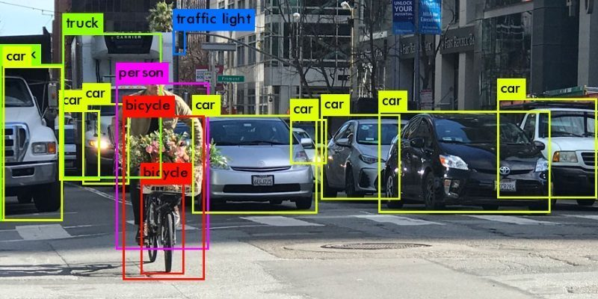
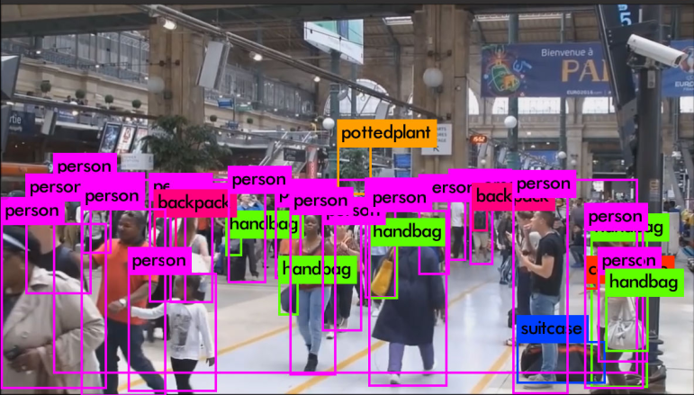
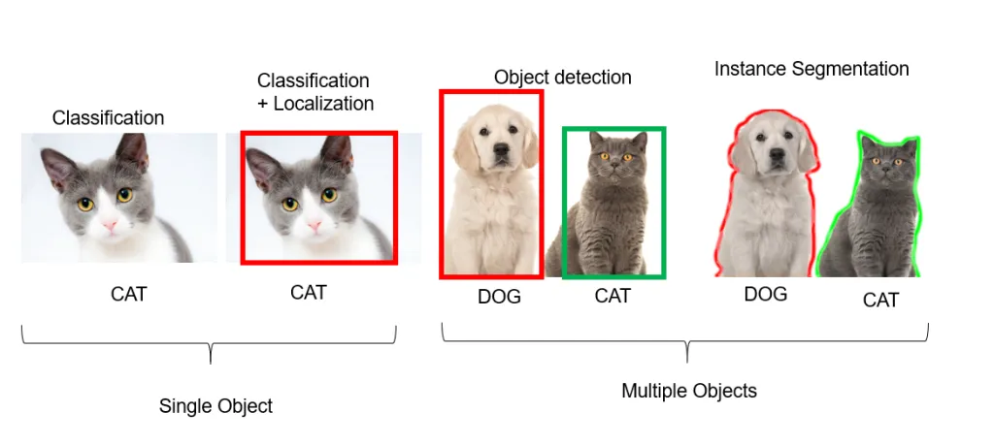
Background & Problem Statement
The need of a customized object detection model dedicated for surveillance & self driving cars
Possibility of modification in state of the art YOLOv4 model in such a way that weights can be concentrated to detect specific classes.

Slide 4
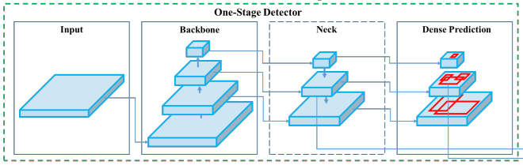
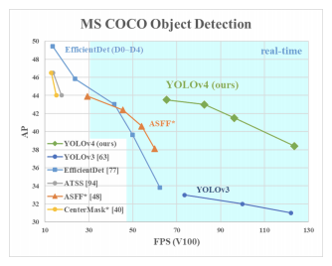
Methodology
Model Architecture (YOLOv4 default)
Backbone (CSPDarknet53)
Feature Extraction
Neck (PANet)
Feature Aggregation
Head (YoLo)
Dense Prediction
Features
Bag of Freebies
Bag of Specials

Slide 5
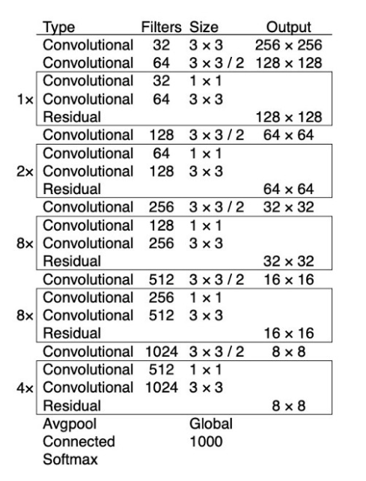
Methodology(Continued)
Model Architecture (YOLOv4 default)
Backbone (CSPDarknet53)
Feature Extraction
Neck (PANet)
Feature Aggregation
Head (YoLo)
Dense Prediction
Features
Bag of Freebies
Bag of Specials

Slide 6
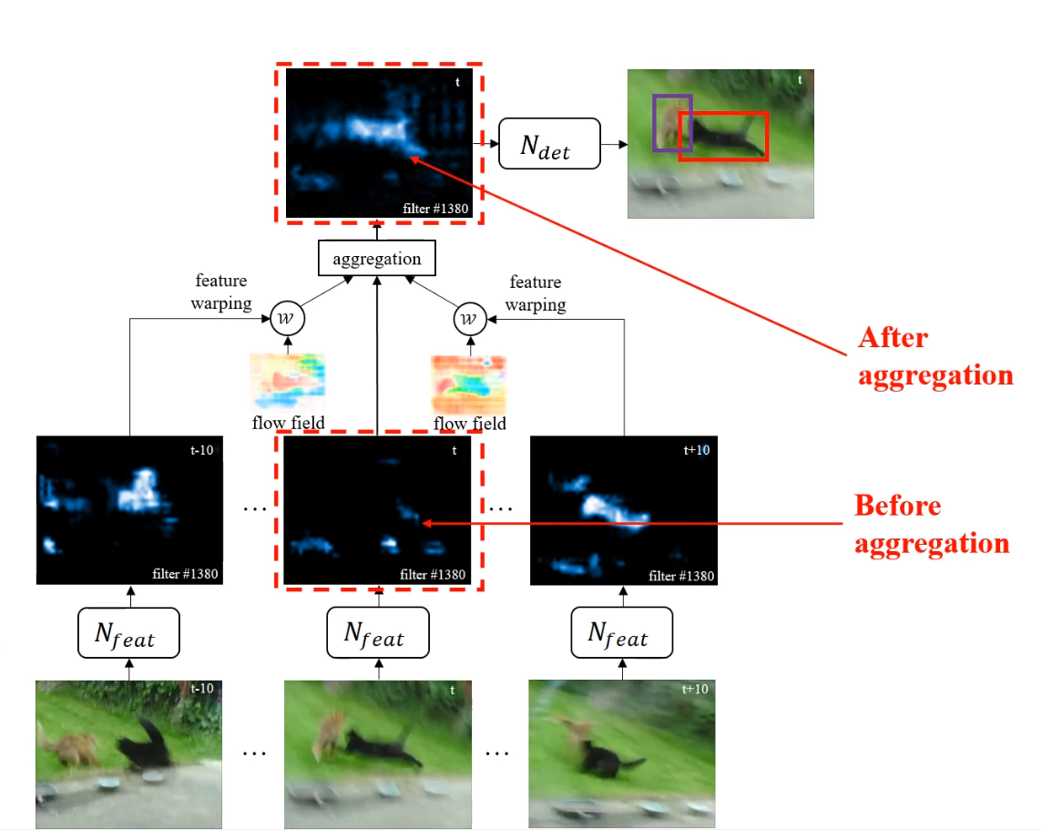
Methodology(Continued)
Model Architecture (YOLOv4 default)
Backbone (CSPDarknet53)
Feature Extraction
Neck (PANet)
Feature Aggregation
Head (YoLo)
Dense Prediction
Features
Bag of Freebies
Bag of Specials

Slide 7
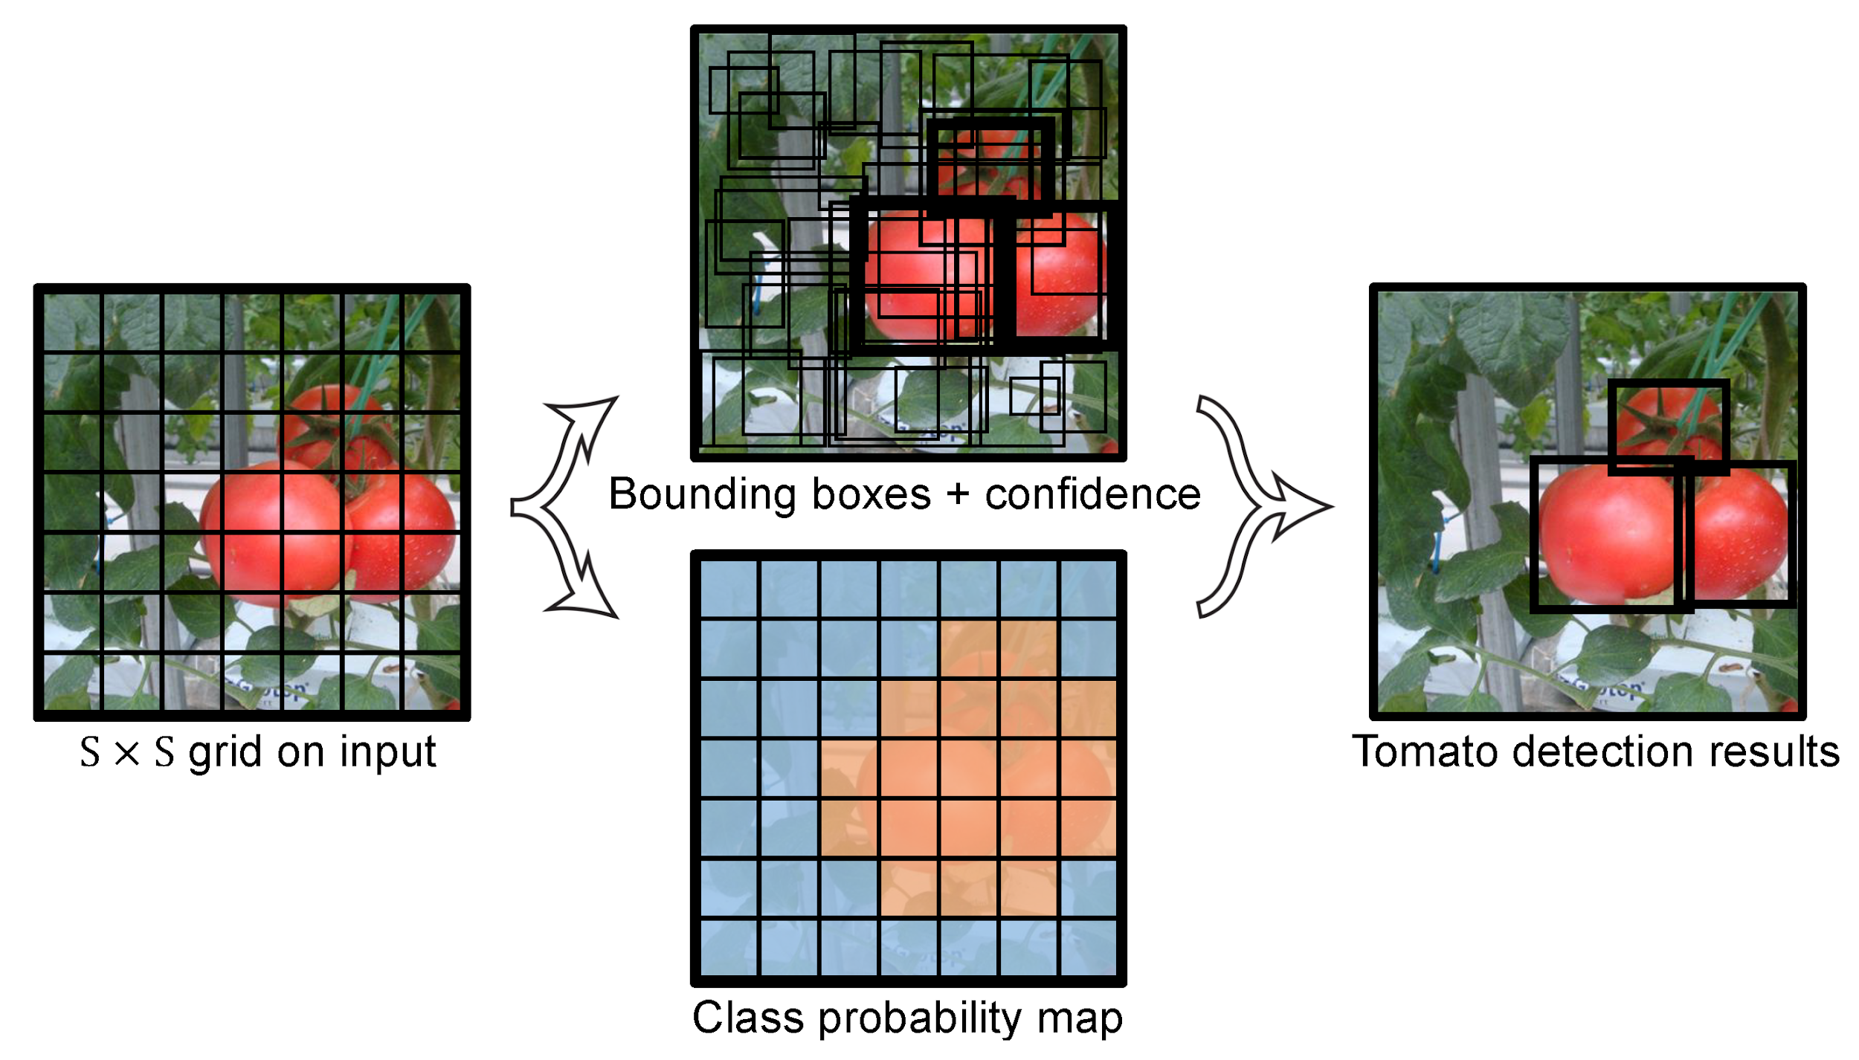
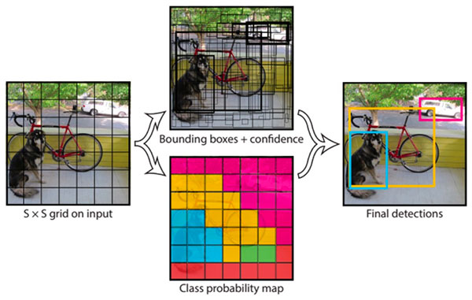
Methodology(Continued)
Model Architecture (YOLOv4 default)
Backbone (CSPDarknet53)
Feature Extraction
Neck (PANet)
Feature Aggregation
Head (YoLo)
Dense Prediction
Features
Bag of Freebies
Bag of Specials

Slide 8
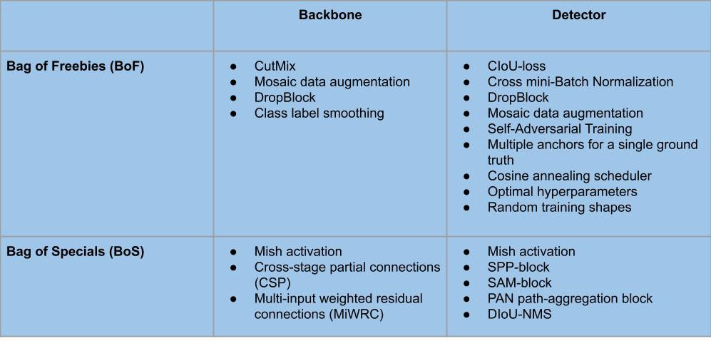
Methodology(Continued)
Model Architecture (YOLOv4 default)
Backbone (CSPDarknet53)
Feature Extraction
Neck (PANet)
Feature Aggregation
Head (YoLo)
Dense Prediction
Features
Bag of Freebies
Bag of Specials

Slide 9
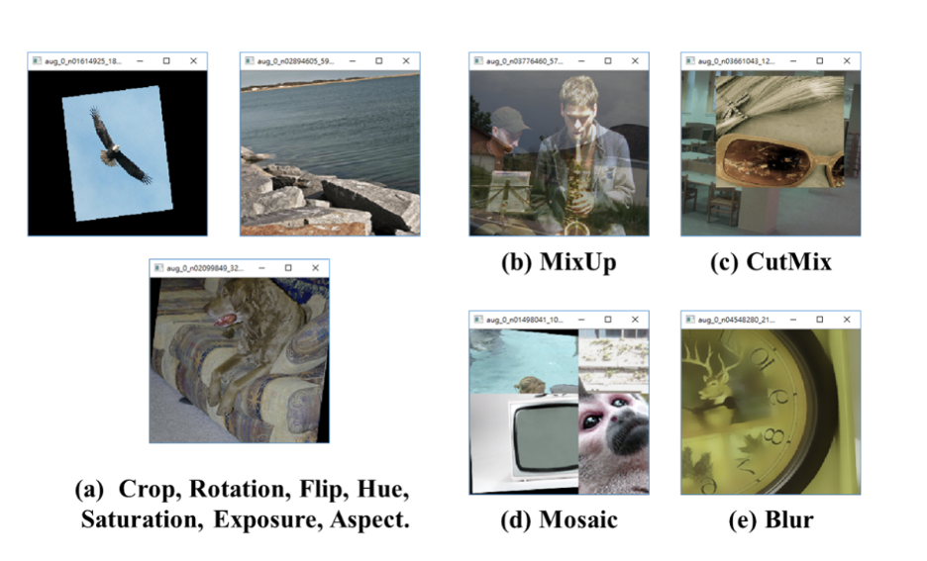
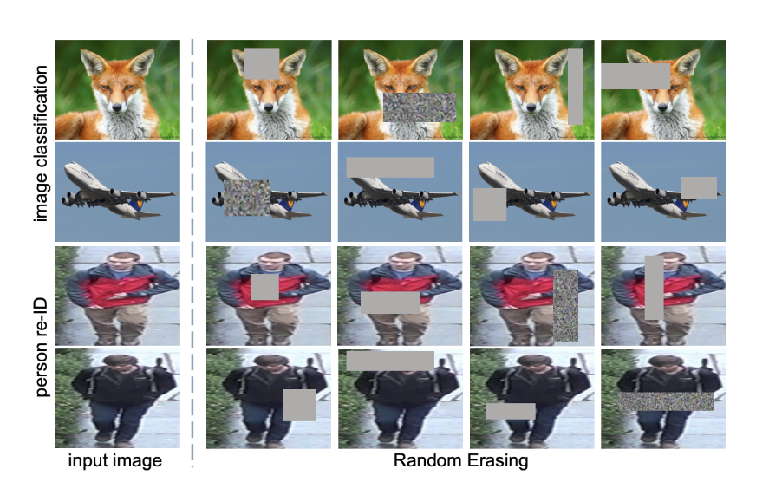
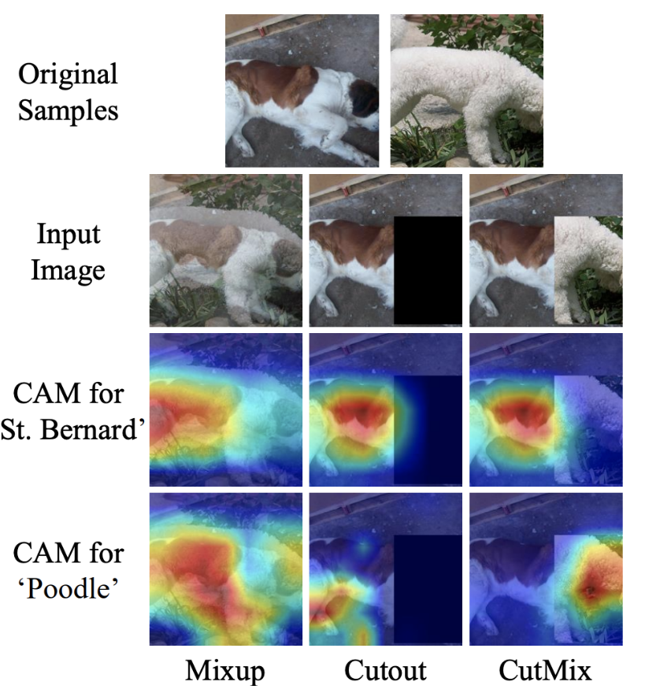
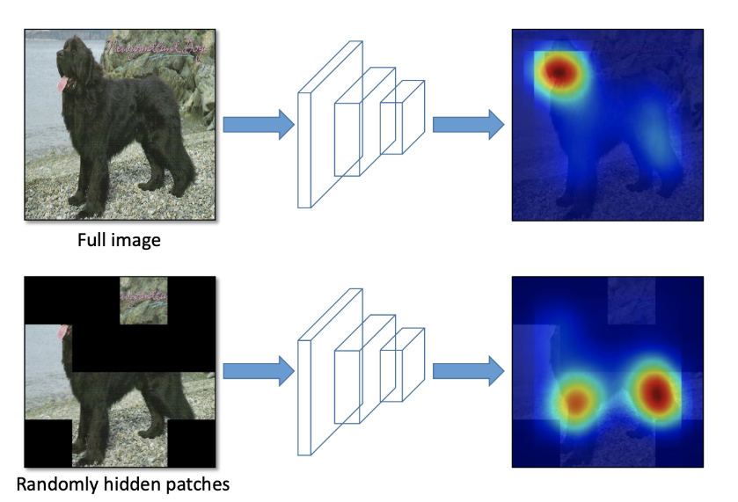
Methodology(Continued)
Model Architecture (YOLOv4 default)
Backbone (CSPDarknet53)
Feature Extraction
Neck (PANet)
Feature Aggregation
Head (YoLo)
Dense Prediction
Features
Bag of Freebies
Bag of Specials

Slide 10
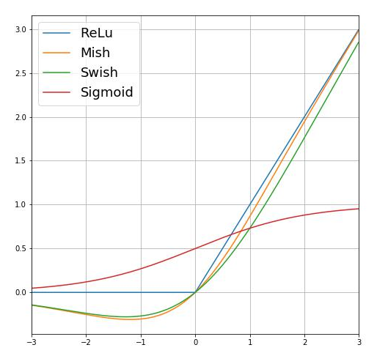
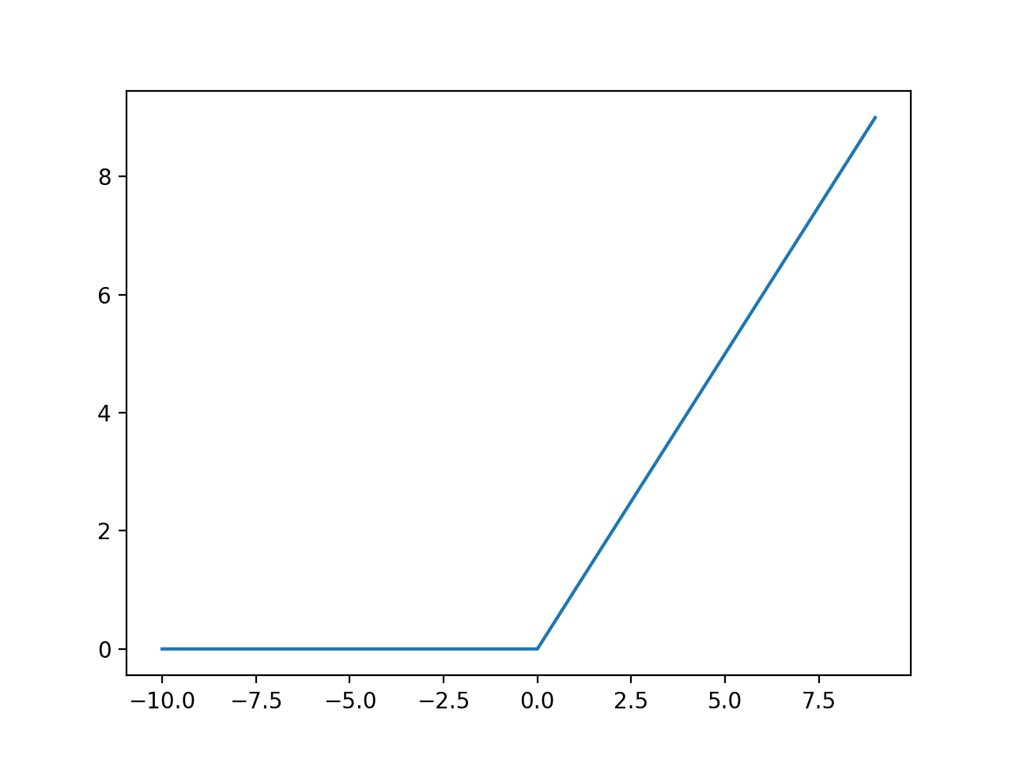
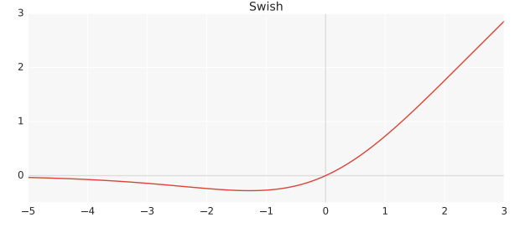
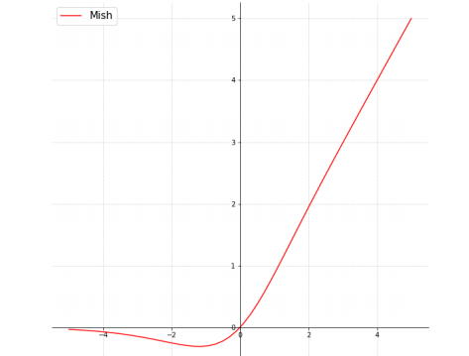
Methodology(Continued)
Model Architecture (YOLOv4 default)
Backbone (CSPDarknet53)
Feature Extraction
Neck (PANet)
Feature Aggregation
Head (YoLo)
Dense Prediction
Features
Bag of Freebies
Bag of Specials

Slide 11
Contributions
Contributions
Model customization
Optimization of training parameters
Dataset Preparation & adjustment for specific classes
Training the model with different class combinations and settings on multiple datasets to optimize the results.

Slide 12
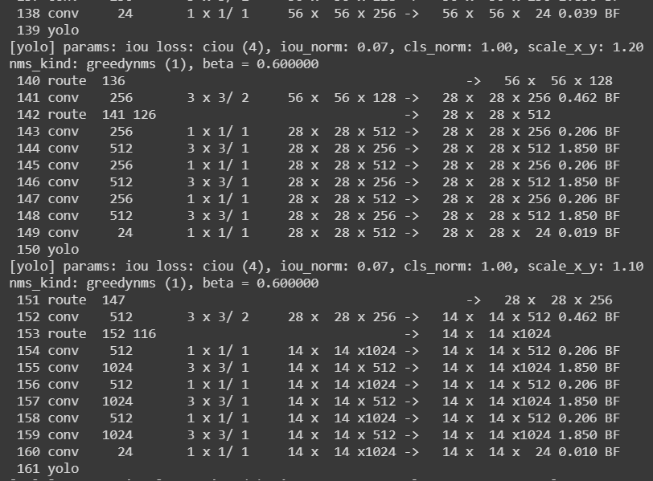
Contributions (Continued)
Model customization
Number of classes reduced (from 80 to 3)
Layers 1 to 137 of Yolov4 are left unchanged. Weights from layer 137 are downloaded for training.
Layer 138 to Layer 161 of Yolov4 is modified to train reduced number of classes
All the weights are now concentrated on specific classes.

Slide 13
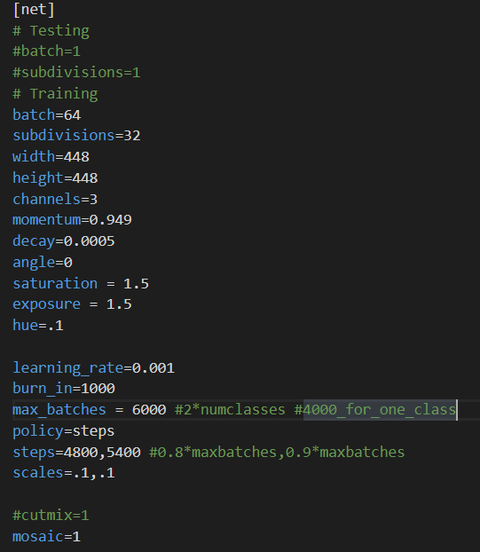
Contributions (Continued)
Optimization of training parameters
Several training parameters can be tweaked.
For optimization, number of subdivisions, learning rate are altered & cutmix method is also tested for data augmentation
Image resizing can also be altered and thus, experimented.

Slide 14
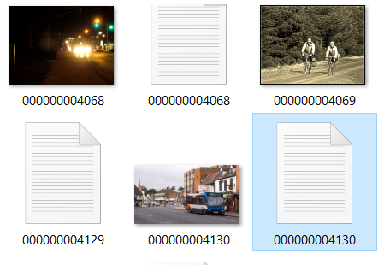
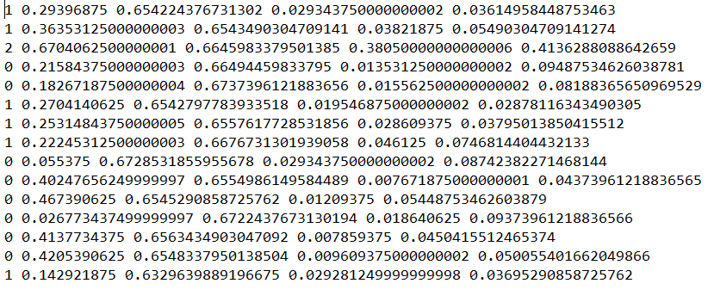
Contributions (Continued)
Dataset Preparation & adjustment
Coco dataset & Google’s OpenImage dataset are used for training with train-test ratio of 90:10 & 80:20 respectively.
Coco dataset does not allow separation of classes upon download and thus, is separated with extra coding
All the annotation files are converted to Yolo format.
Corrupted images and annotations are inspected and labelled manually using labelImg

Slide 15
Contributions (Continued)
Training the model
The model is trained in three different styles to compare & analyze the results
Version 1 (Single class separate detectors)
Version 2 (Two class detector)
Version 3 (Three class detector)
Version 1 & 2 are trained with OpenImage dataset and Version 3 is trained on Coco dataset
The trained models are then evaluated with both training & testing datasets.

Slide 16
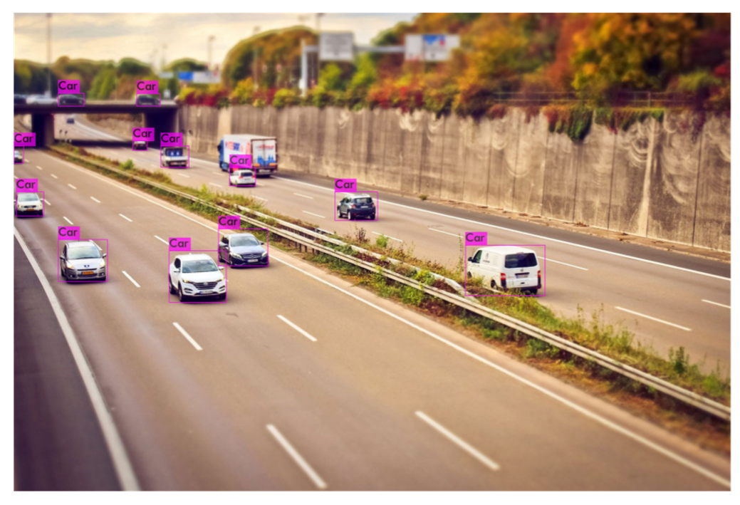
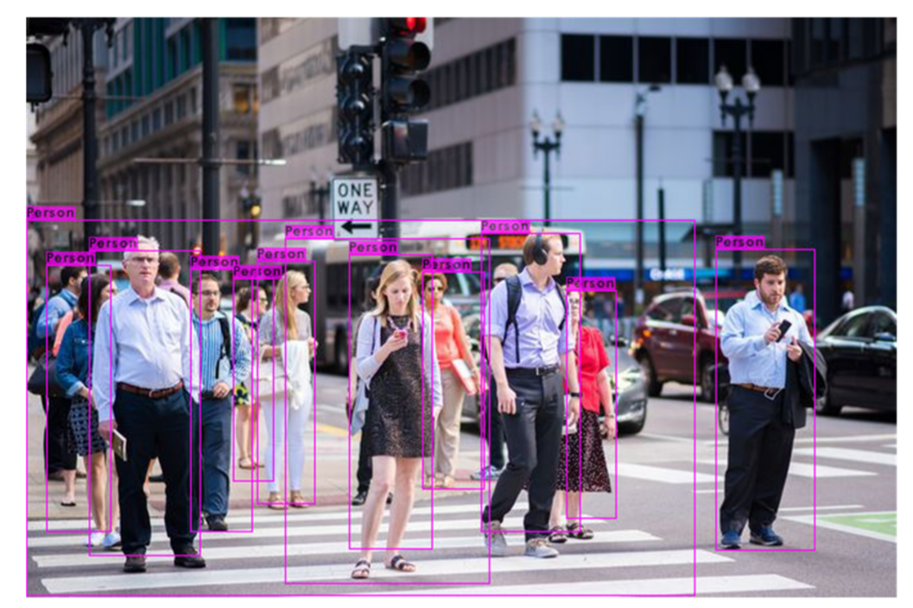
Results & Evaluation
Version 1 (Single Class Detectors)
Single class detectors are first trained for “car” & “person” classes respectively with 4000 images each from Google’s OpenImage dataset.
The models are trained for 2000 batches and achieved final loss values of 2.6 for “car” and 2.8 for “person”
The training time is approximately 9 hours for each class.

Slide 17
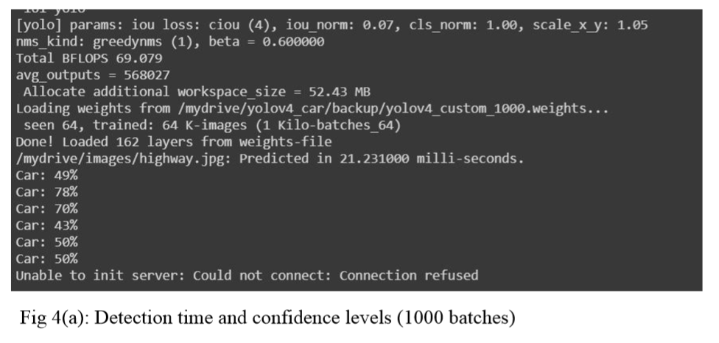
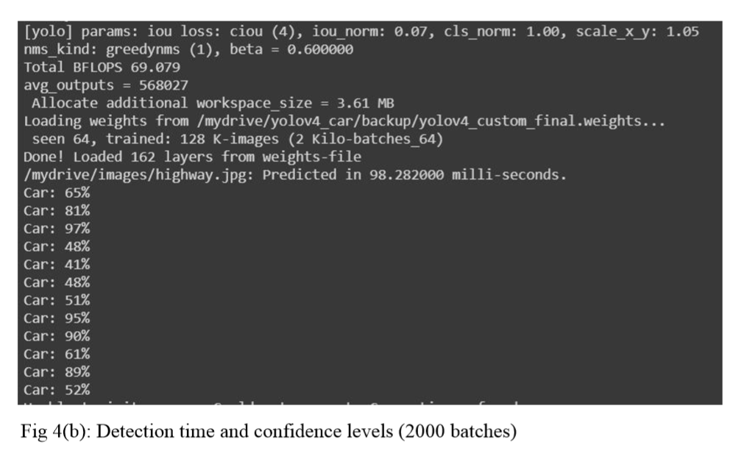
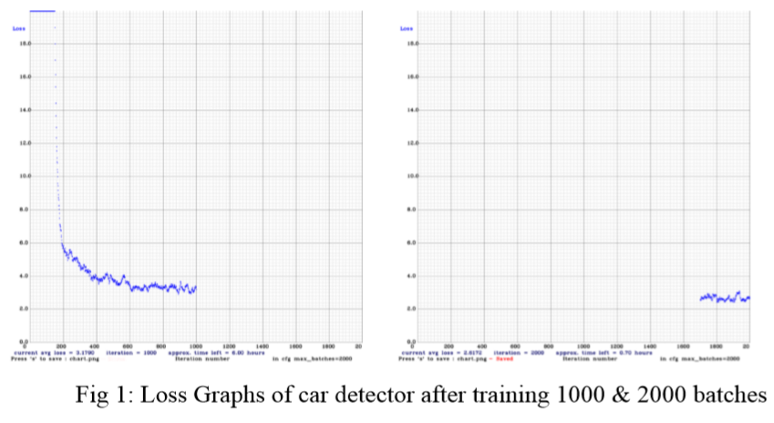
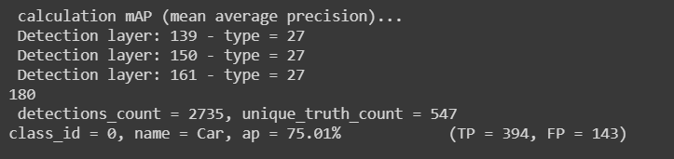
Results & Evaluation(Continued)
Version 1 (Single Class Detectors)
Prediction time is ~98.5 ms for each frame with 12 FPS. FPS can be doubled to 24 by using 1000 iteration weights, thus, sacrificing accuracy.
MAP values are 75% for car class and 68% for person class respectively tested on a subset of OpenImage’s training dataset.

Slide 18

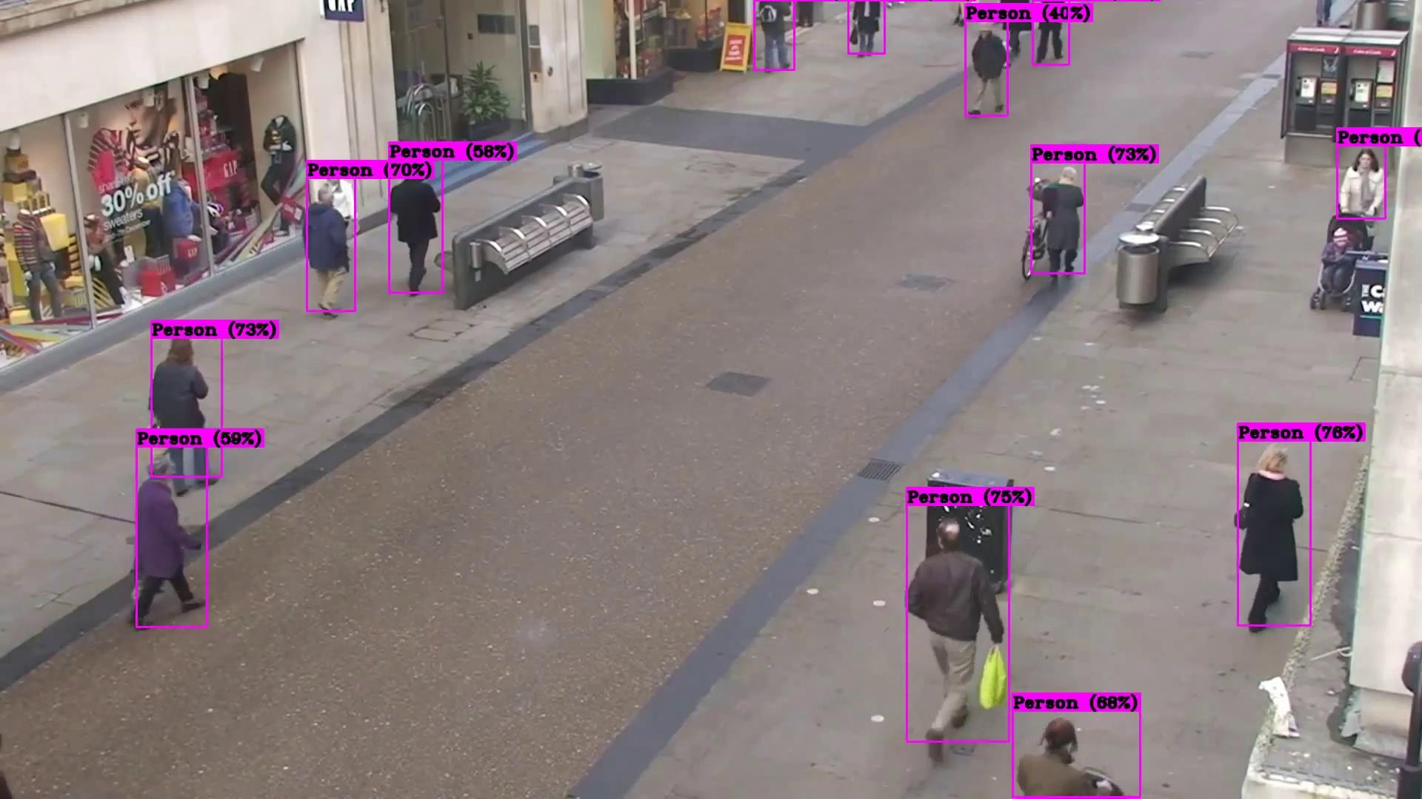
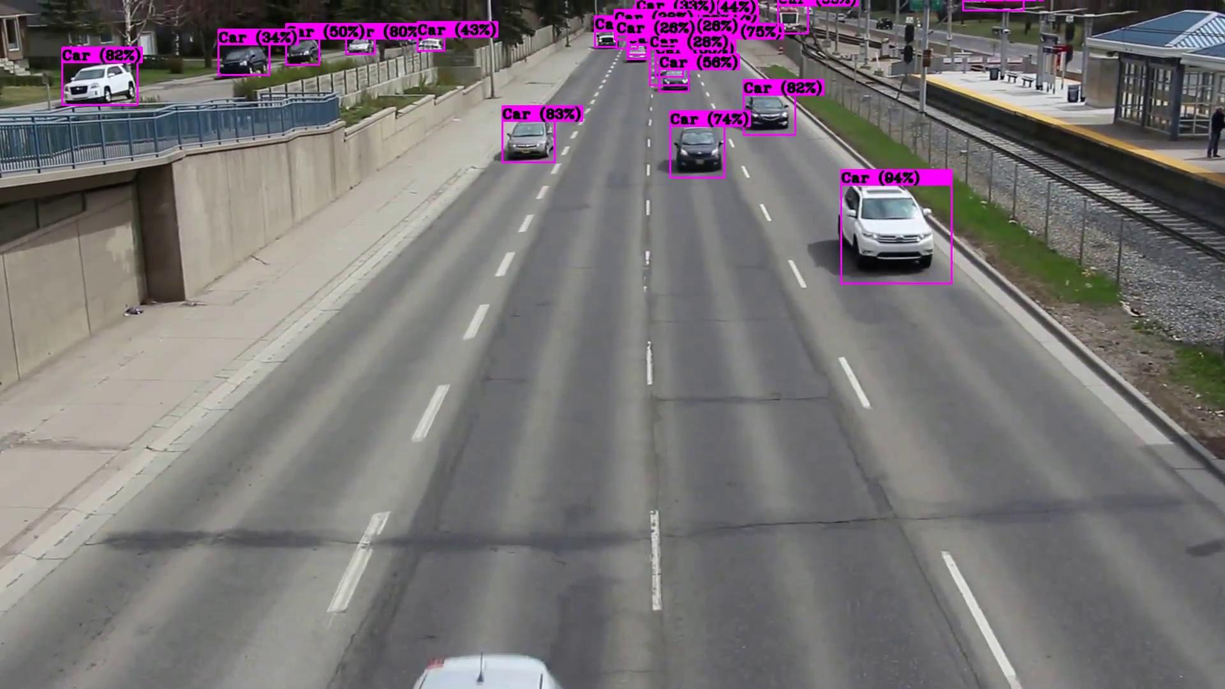
Results & Evaluation(Continued)
Version 1 (Single Class Detectors)
.

Slide 19
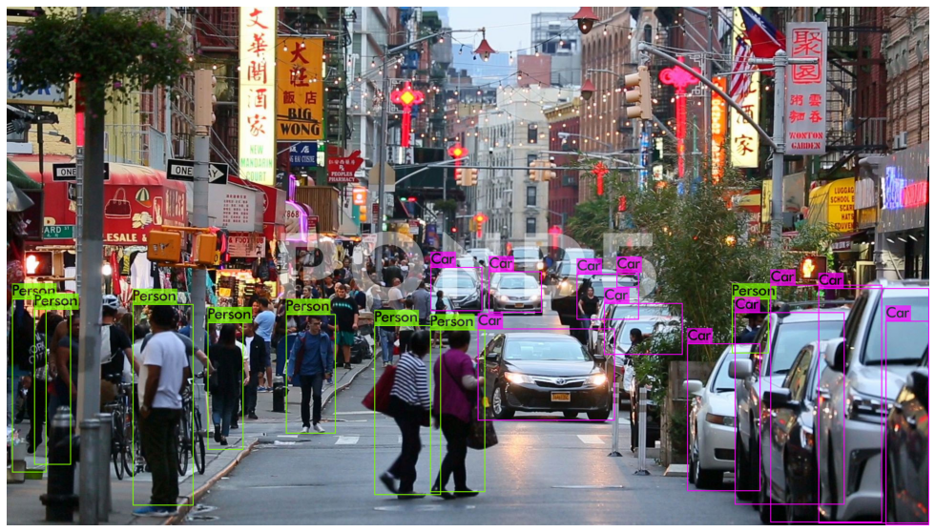
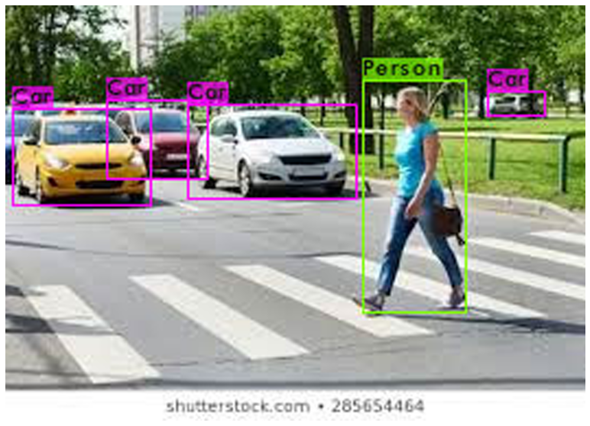
Results & Evaluation(Continued)
Version 2 (Two Class Detector)
“Car” and “Person” classes are trained together as a multiclass detector, with 5000 images from Google’s OpenImage dataset, 2500 images for each class.
The model is trained for 4000 batches final loss value is stuck at 3.5
The model is then trained again with same settings until 5000 batches and loss further decreased to 3.2
The total training time is approximately 16 hours.

Slide 20
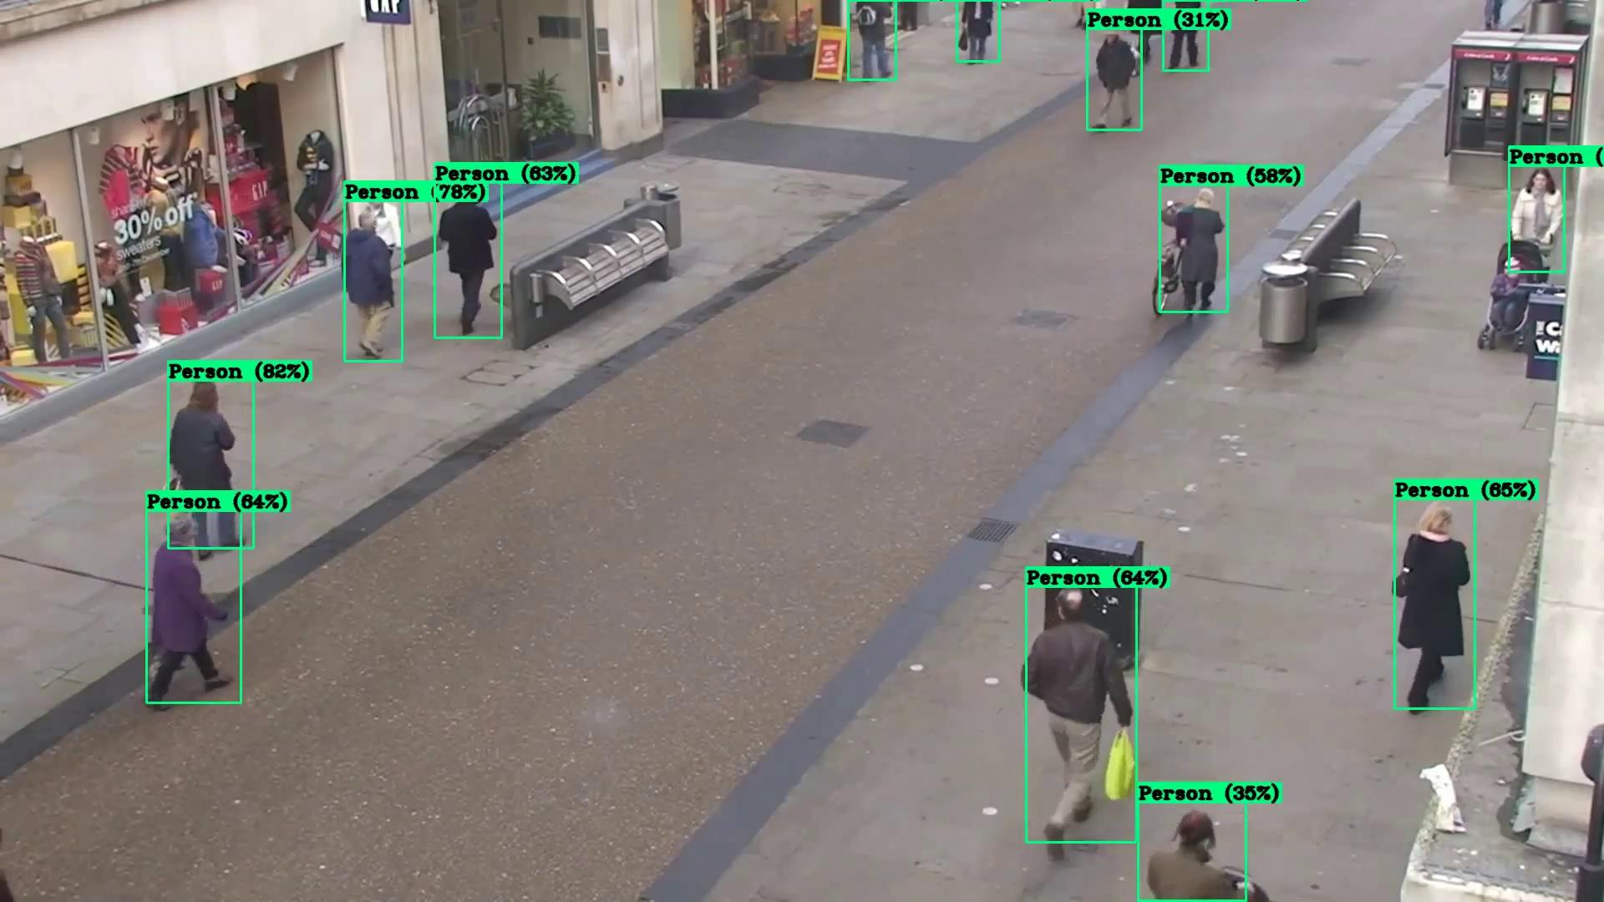
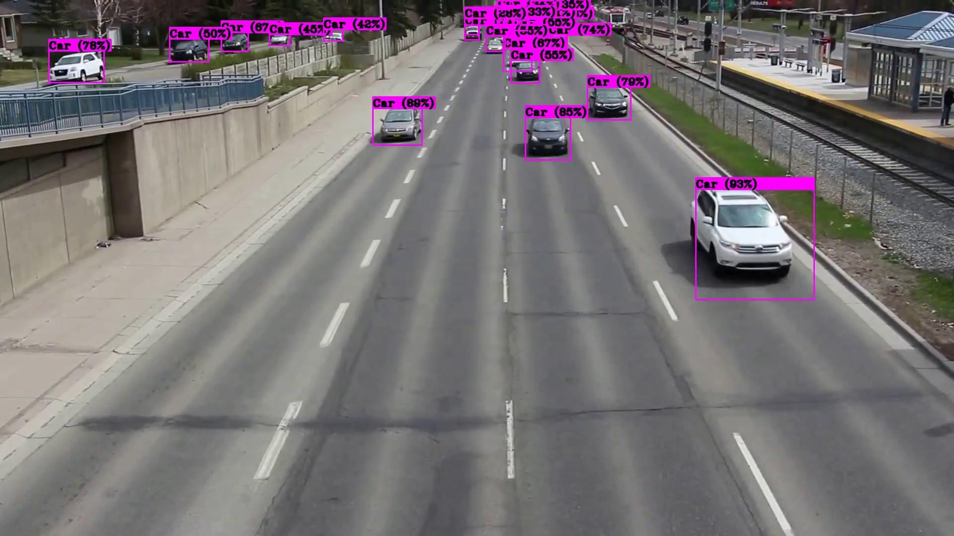
Results & Evaluation(Continued)
Version 2 (Two Class Detector)
Prediction time remains at ~98.5 but FPS drops to 11.5
MAP values are not impressive yet. After 5000 batches trained, Car class saw an increase with 83.28% MAP on OpenImage testing dataset but person class MAP is at a mediocre 48.3% , thus averaging the MAP of this detector to 65.8%
4000 batches version previously achieved average MAP of 64.62% and thus it is a 1.2% increase.

Slide 21
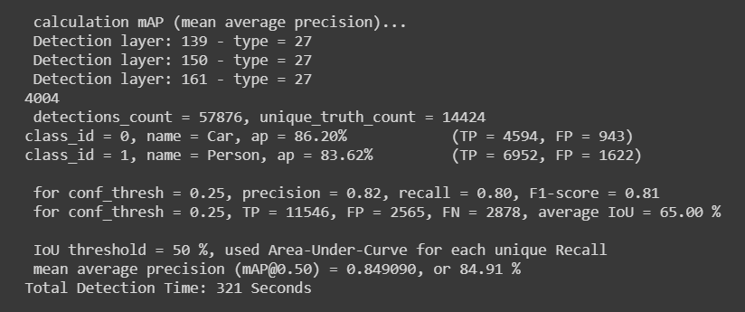
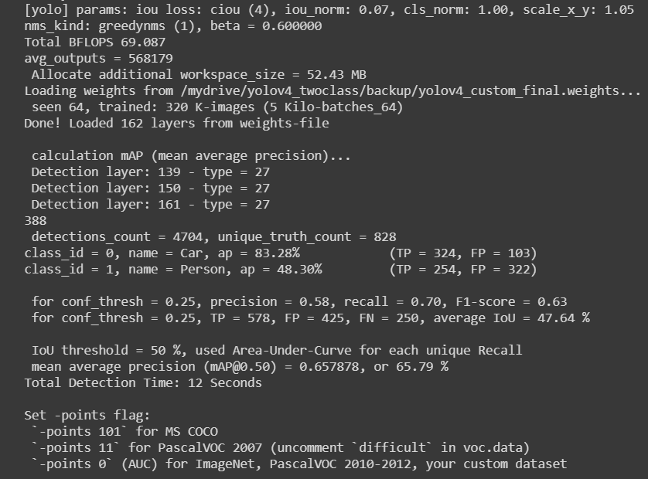
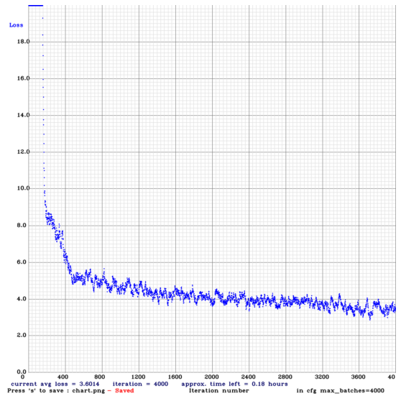
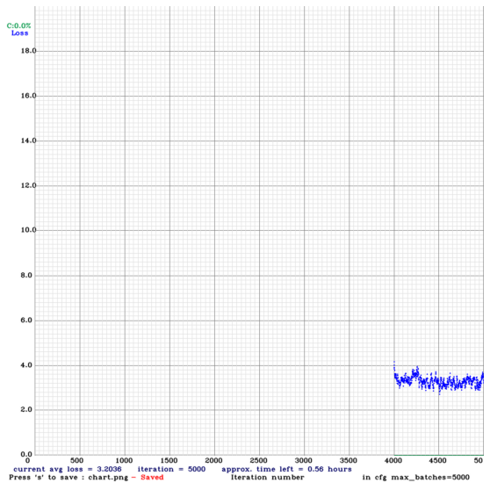
Results & Evaluation(Continued)
Version 2 (Two Class Detector)

Slide 22
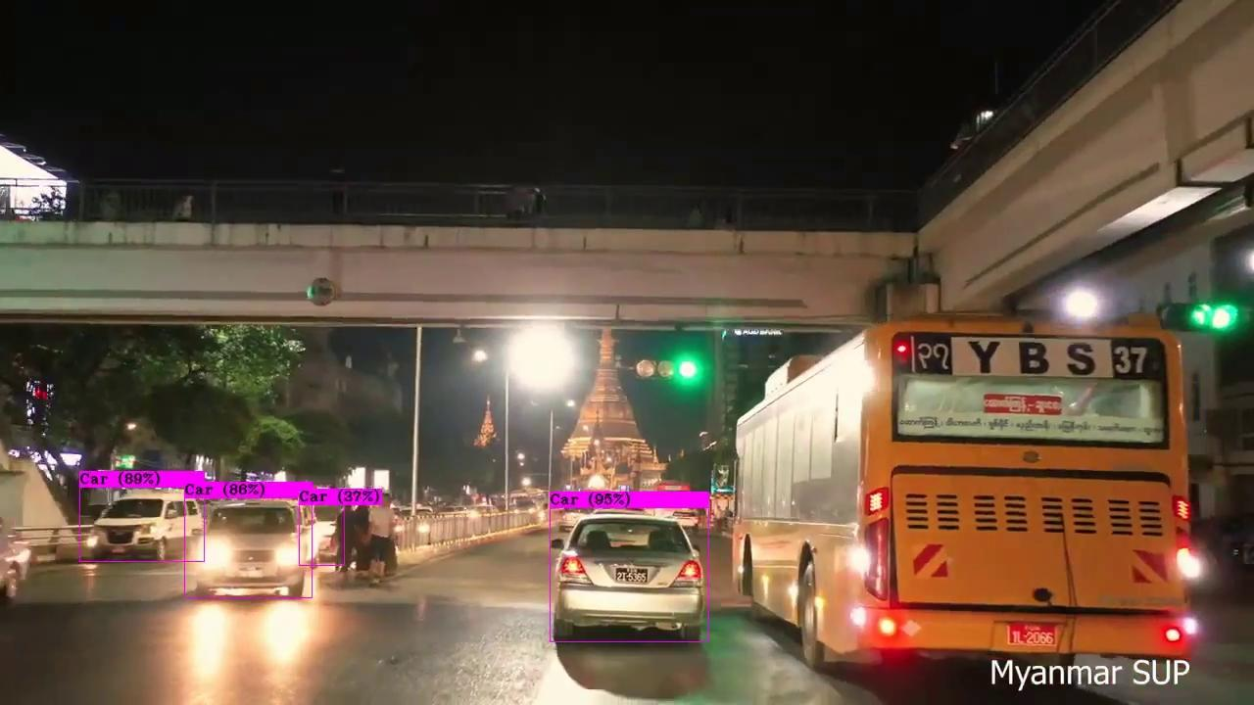
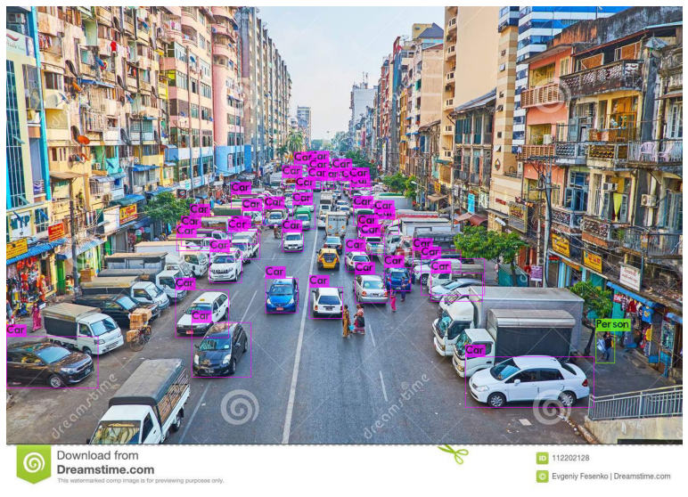
Results & Evaluation(Continued)
Version 2 (Two Class Detector)
As we can see here, this version can detect cars very well but still struggles in detecting pedestrians
This is concluded to be the cause of small size of the data used and the problem is tackled in the next version

Slide 23
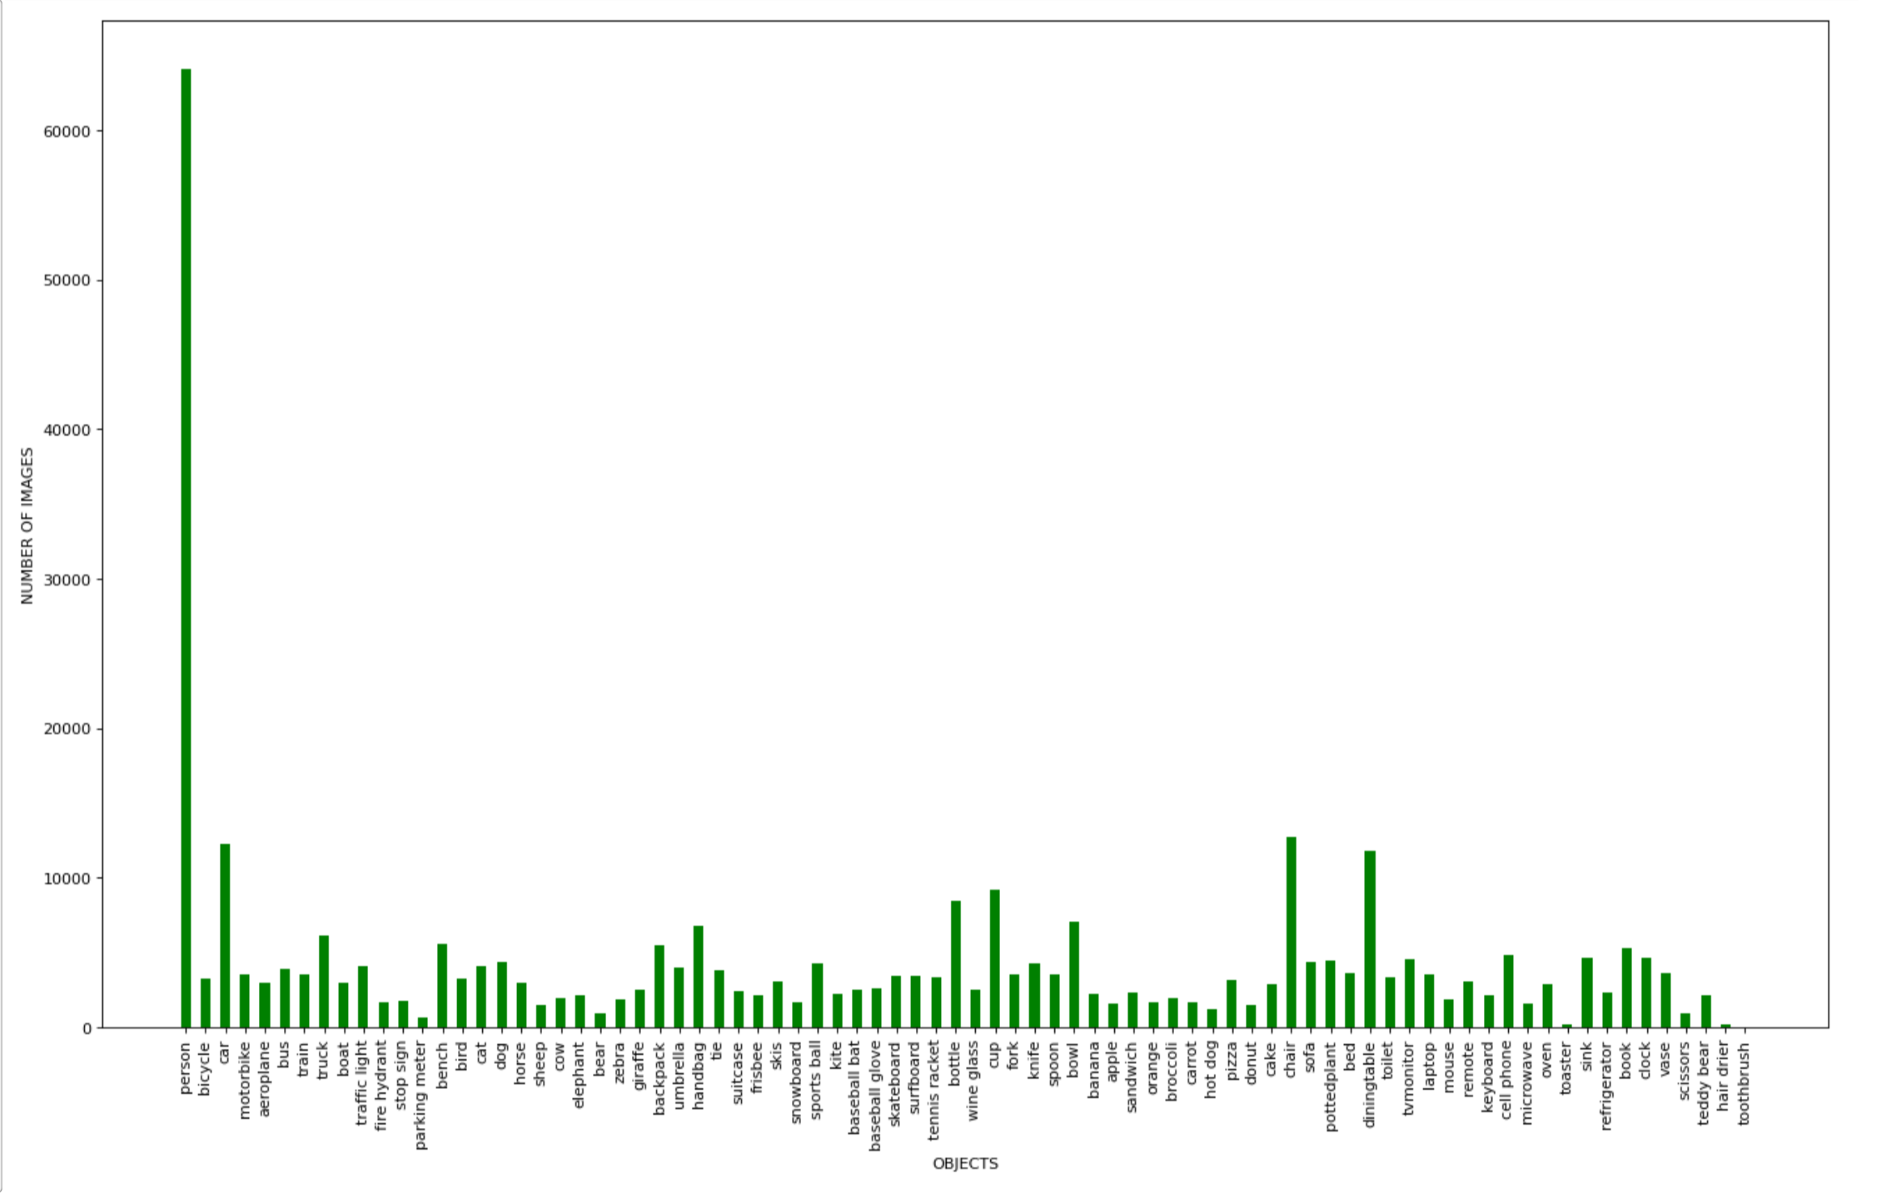
Results & Evaluation(Continued)
Version 3 (Three Class Detector)
“Bus” class is added and the three classes are trained with 65,000 images from COCO dataset, 13 times more images than the previous version
COCO dataset distribution means unbalanced data, but the person class seem to require more data due to previous findings
After training for target 6000 batches loss values remained at 3.46
Total training time is ~15 hours

Slide 24
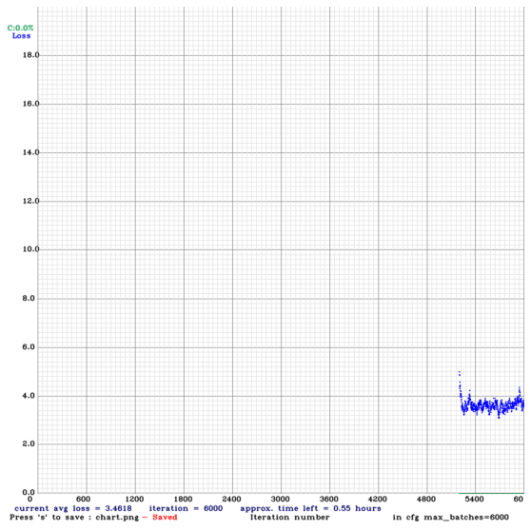
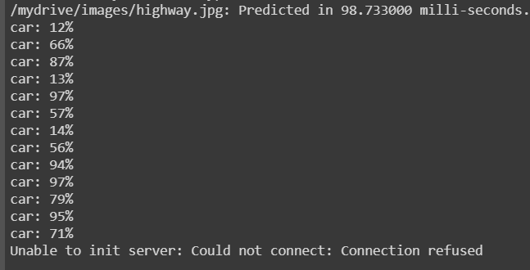
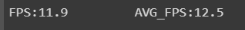
Results & Evaluation(Continued)
Version 3 (Three Class Detector)
Prediction time is at ~98.7ms at 12.5 FPS
Average MAP values on coco dataset is 79.3% on training set and 78.4% on validation set.
MAP for person class is significantly increased but MAP for car class slightly decreased.

Slide 25
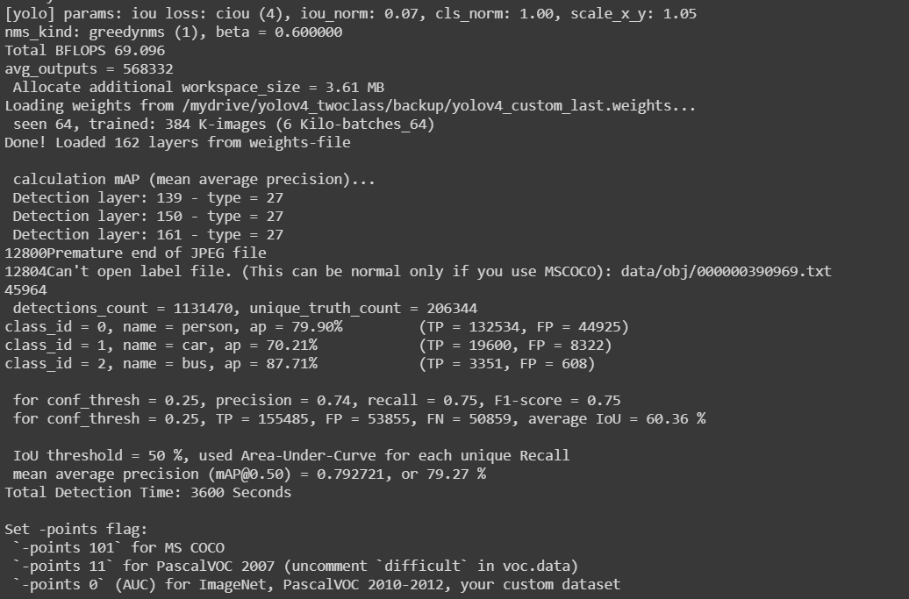
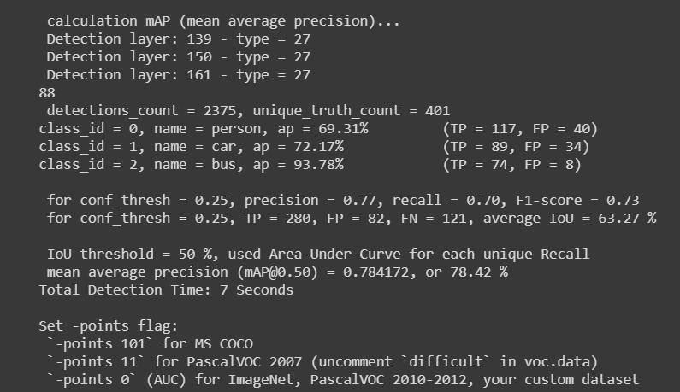
Results & Evaluation(Continued)
Version 3 (Three Class Detector)

Slide 26
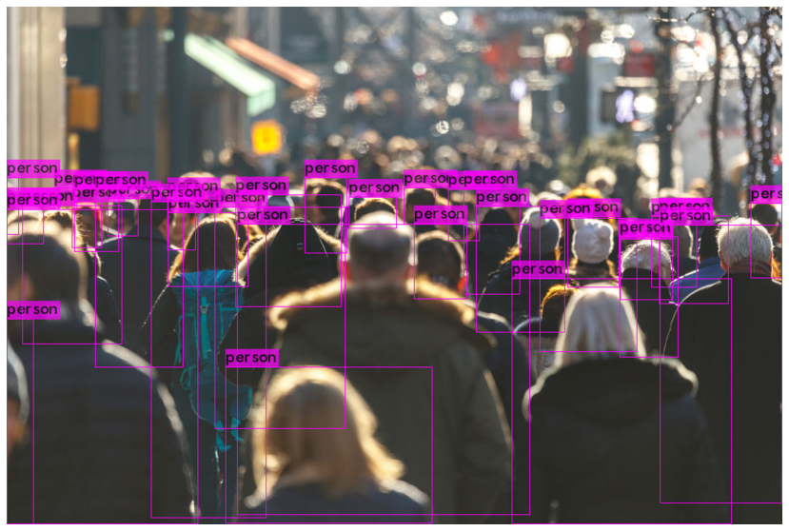
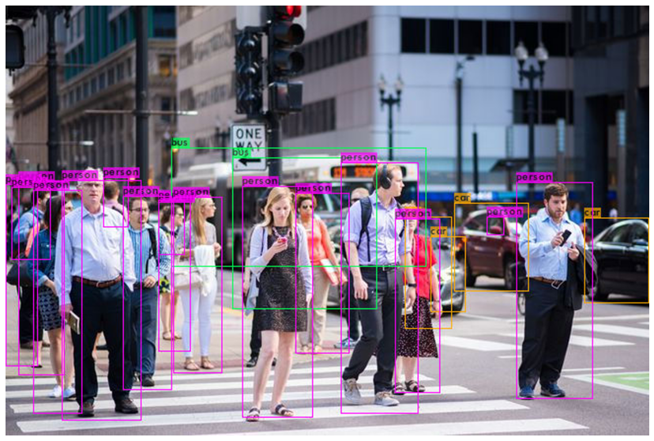
Results & Evaluation(Continued)
Version 3 (Three Class Detector)

Slide 27
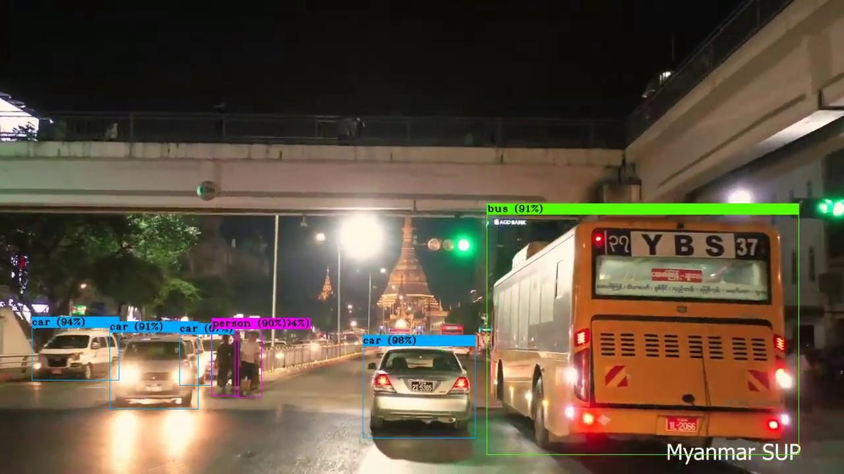
Results & Evaluation(Continued)
Version 3 (Three Class Detector)
As we can see in the video, this version runs very well and is efficient for detecting all three classes

Slide 28
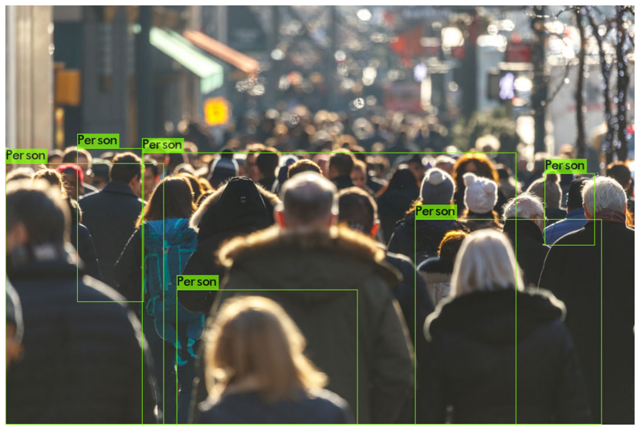
Results & Evaluation(Continued)
Version 3 (Three Class Detector) Vs Version 2 (Previous two class detector)

Slide 29
Results & Evaluation(Continued)
Version 3 (Three Class Detector) Vs Version 2 (Previous two class detector)

Slide 30



Results & Evaluation(Continued)
Comparison of three versions Vs YOLO v4 Original

Slide 31


Results & Evaluation(Continued)
Version 3 (Three Class Detector) Vs YOLO v4 Original

Slide 32
Conclusion
Yolov4 is customized and trained in three different versions with different settings
It is discovered that person class requires more data to perform well
Data imbalance in version 3 causes decrease in MAP of other classes, the ratio of the dataset distribution should be tweaked to improve precision.
This MAP can be increased by training more batches but it can eventually result in overfitting.
In terms of performance, current version 3 almost matches the Original Yolov4 in trained classes with a better FPS rate. It can also predict images twice faster.

Slide 33
Future Works
Next versions will be trained with a different data distribution ratios to further increase precision for detecting cars.
Yolov4-tiny will also be tested as a new model to increase FPS.
The final detection model will be combined with deep-SORT tracking algorithm to perform object tracking

Slide 34
End
Thank You For Your Attention.
Notes:
Work in indoor system

